Slide 1

BUSINESS PROBLEM SOLVING SOCIAL MEDIA COMPANY : SOCIAL BUZZ
By Sudhansu

Slide 2
AGENDA
Objective
Background
Key findings
Recommendations
Appendix
Data sources
Assumptions & methodology

Slide 3

Objective
Analyzing Social Buzz posts and reactions data to extract insights useful for making business decisions.

Slide 4
Background
Social Buzz scaled quicker than anticipated, the amount of data created is huge and highly unstructured.
Over past 5 years, it has reached over 500 million monthly active users. Everyday over 100k piece of contents are posted. They are still a small company and need recommendations for their business decision making.

Slide 5
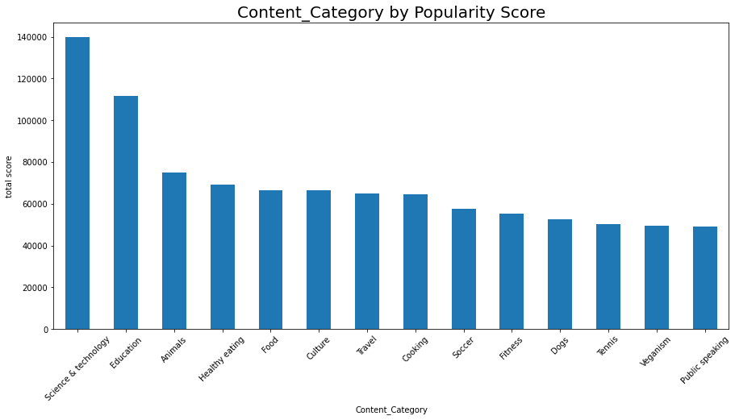
Key Insights
Science & Technology is the most popular category in Social Buzz followed by Education and Animals

Slide 6
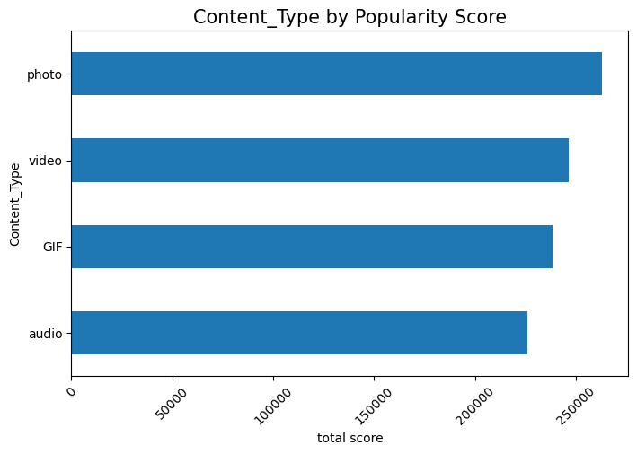
Photo is the most popular content type in Social Buzz.

Slide 7
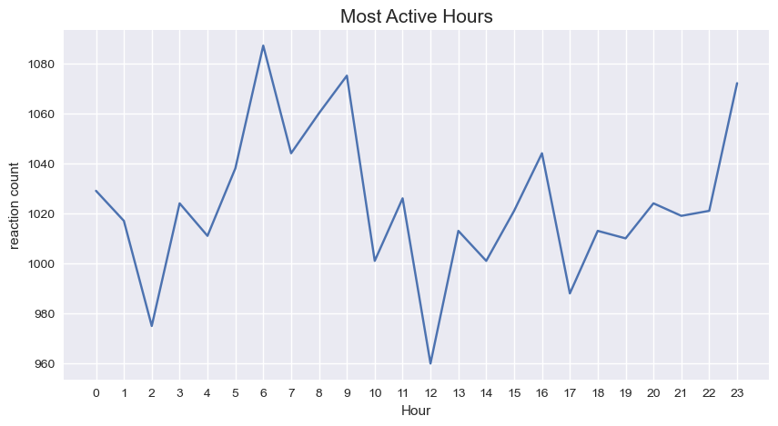
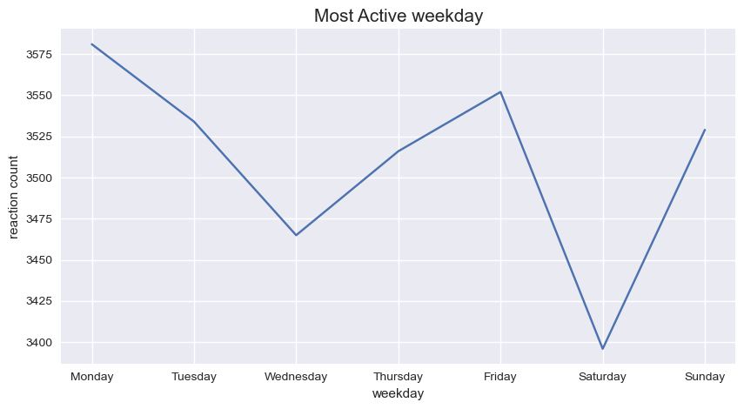
Users are most active in morning between 6am to 9am and around 11pm at Night
Monday is the most active day followed by Friday and Sunday

Slide 8
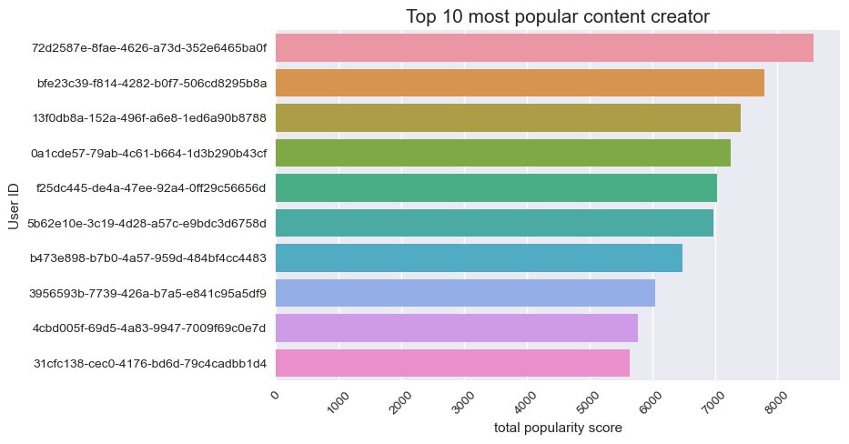

Slide 9
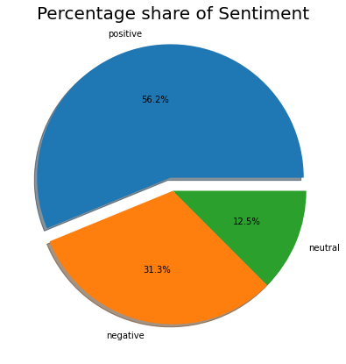
Most posts are positive (56%)
with 31% negative and 12% neutral

Slide 10
Recommendations
As Science and Technology is the most popular category with maximum posts followed by Education and animals, social buzz can collaborate with brands related to these categories and can run campaigns to increase engagement.
As Photos is the most popular content type, social buzz can optimize their recommendation algorithm to promote more photo contents to the user's feed.
Users are most active on Mondays, Fridays and Sundays in the early morning and at late night, social buzz run add campaigns and events around this period for more reach.
Company can reward top creators to encourage more content creation.

Slide 11
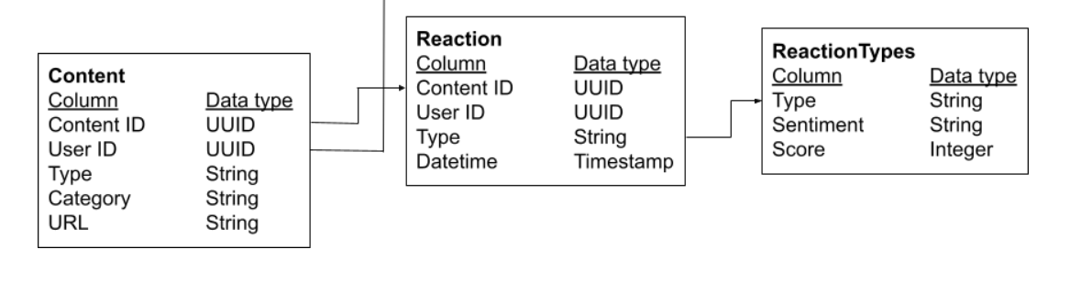
Data Sources
Did Data cleaning in python jupyter notebook
merged Content, Reaction and ReactionTypes table by inner join
Assumptions and Methodology
We have randomly taken the data of 1000 posts and reactions on them over one year.
Plotted visualisation using seaborn and matplotlib python libraries.

Slide 12
Thank you

